Slide 1
History of Mantik and Abitz Families Where Did I Come From?

Slide 2
History of Mantik Family

Slide 3
We know very little about the Mantik family history
We do not talk about that…
Fred – “About the history of the Mantik family, I wish I knew more. About Michael never mentioning the Old Country or Amelin, I think it might have been more about his dad Joseph and the farm. He wanted to talk about it, but it was so sad no one wanted to listen.”

Slide 4
We know very little about the Mantik family history
We do not talk about that…
Enos (interviewed by David Mantik) - As in any extended family, the past is not always perfect, but Enos preferred not to think or talk about such things.

Slide 5
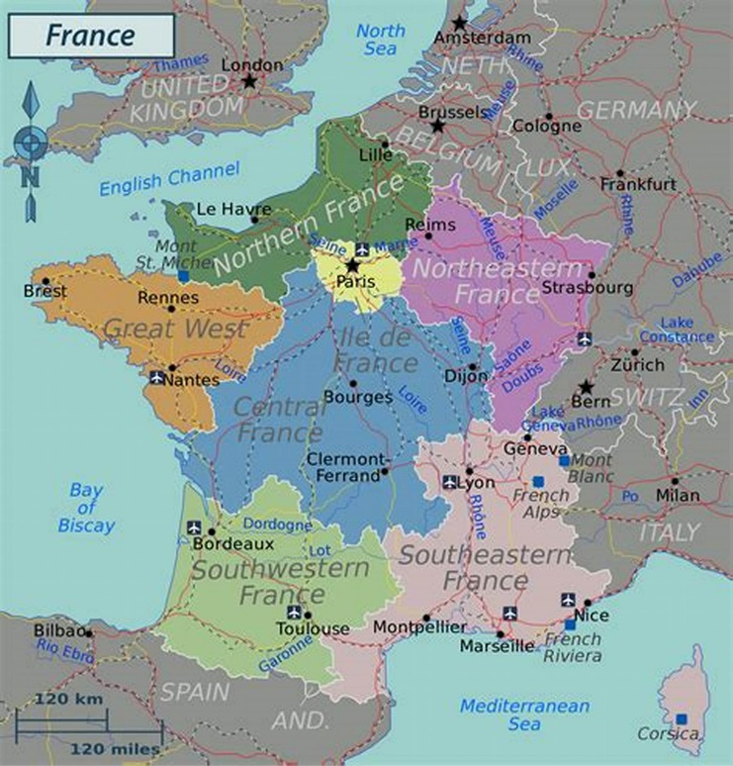
Origins in France
de Manthe
Lived among the Protestants (Huguenots)
Religious wars
1685 - Edict of Nantes revoked

Slide 7
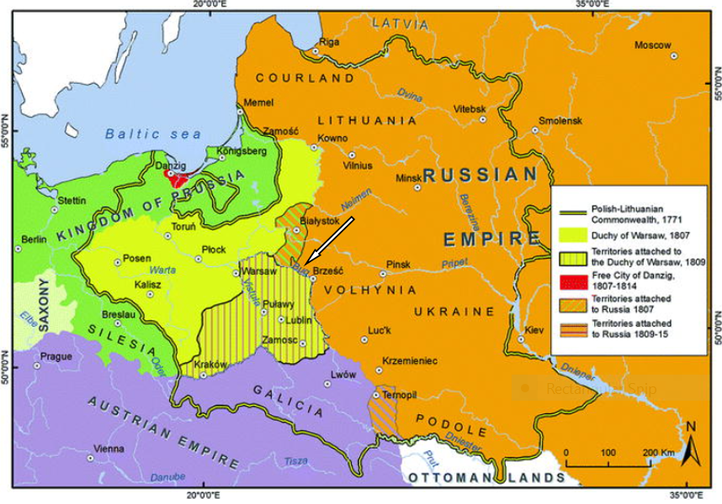

Slide 8
Joseph Mantei/Mantik born 1851 in Kalisz Justine Mantei born 1852 in Kalisz

Slide 9
Joseph moved from Kalisz to Volhynia, Ukraine About 1860s (?) Czar freed serfs in 1861

Slide 10
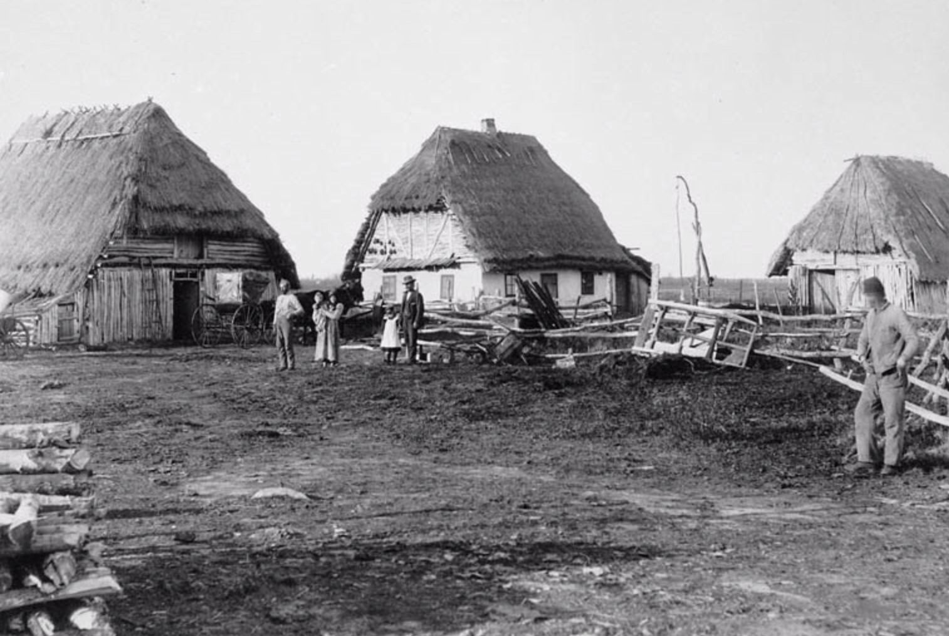
Ukraine Farms

Slide 11
Volyhnia - Ukraine

Slide 12
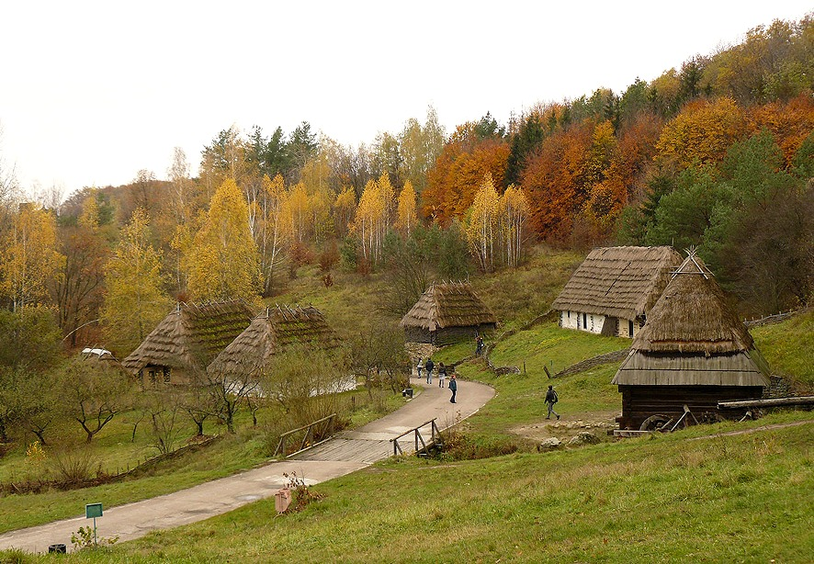
Volhynia - Ukraine

Slide 14
Joseph and Justine Mantei married in 1870 in Zhitomir
Joseph was 19 years old
Justine was 17 years old
Both had red hair

Slide 15
Joseph
Leader in local German community
Represented Germans to Russians
Alcohol problem (possible)
Financial difficulty with farm
Justine died 1894 (when Michael was 8 yr old)
Joseph remarried to Emile (Emilie) with 4 children

Slide 16
Michael J Mantik
Born in 1886 in
Tutschin, Volhynia, Ukraine

Slide 17
Michael J Mantik
7 biological siblings
1 half brother died in infancy
4 stepsiblings

Slide 18
1907 – Michael Came to America
Lusitania – maiden voyage
Used the identity of brother August (2 years younger)
Voyage about 20 days

Slide 19
From Ukraine to Latvia to Liverpool
Emil
Emilie

Slide 20
Why Did Michael Leave the Ukraine?
He was 20 yr old and about to be drafted into Russian army

Slide 21
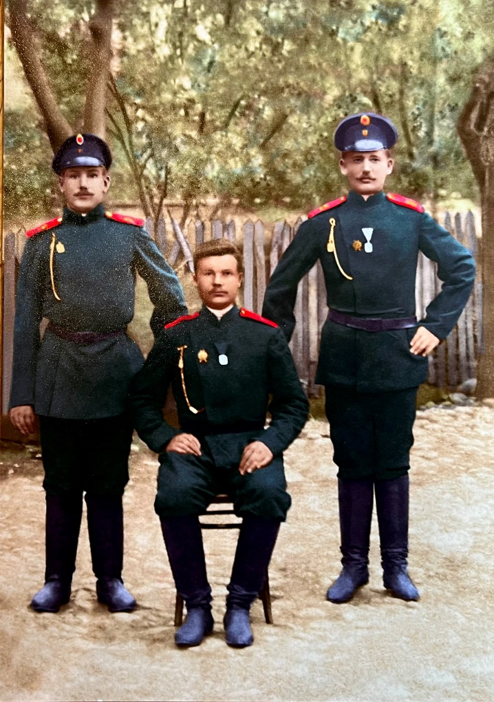
Emil Siewert Drafted in 1898 (age 22) by Russian Army

Slide 22
Why Did Michael Leave the Ukraine?
His mother Justine died when he was 8 yr old
His father remarried. Stepsiblings.
His father died before Michael left for America
His older brother Heinrich had taken over the farm and may have had an alcohol problem

Slide 23
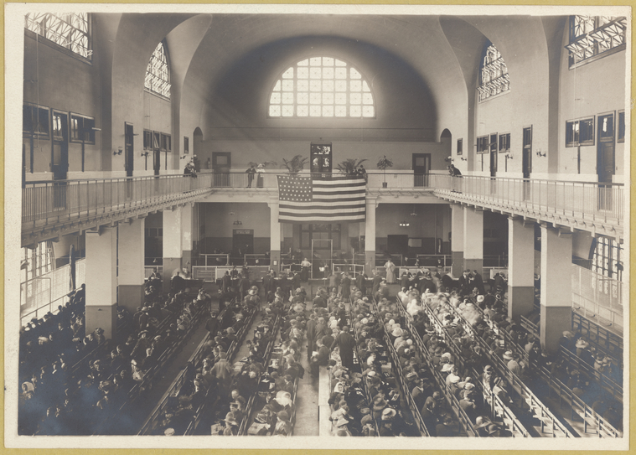
From Liverpool to Ellis Island in New York

Slide 24
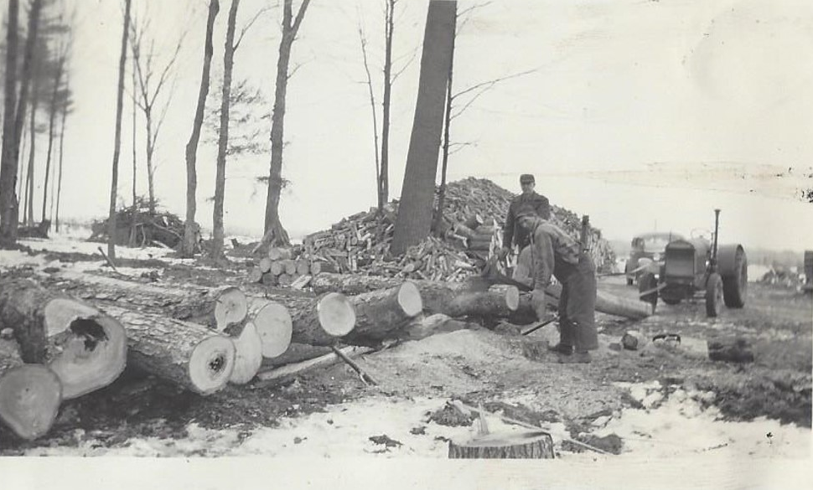
From Ellis Island in New York to Athens
Michael worked at sawmill

Slide 25
History of Abitz Family

Slide 26
Elise Elsie Hedwig Abitz
Born in Pomerania in 1893
Family had lived in that area
for many years
One of 9 children
(2 died in infancy)

Slide 28
Elise Elsie Hedwig Abitz
Came to America at age 14 with mother and some of siblings

Slide 29
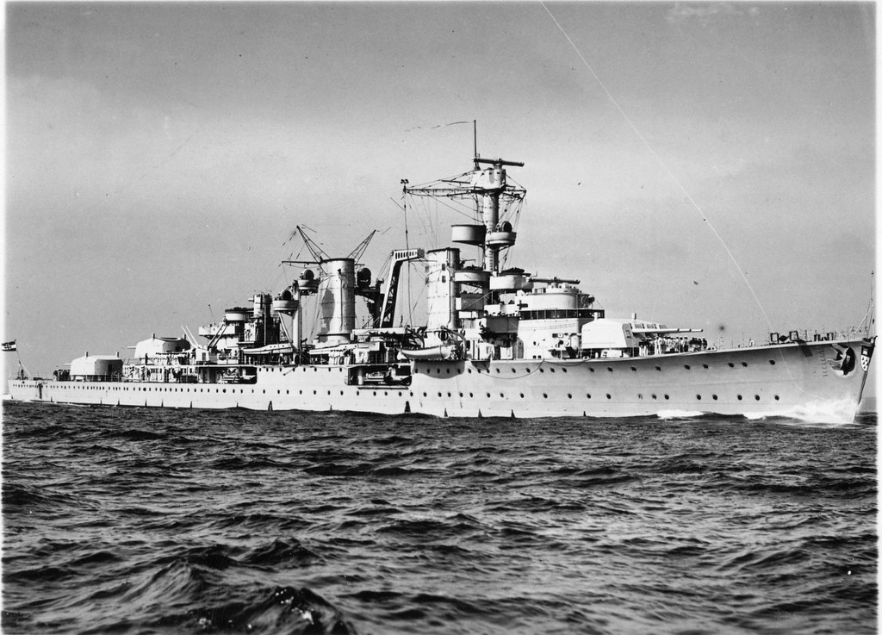
In 1907 took Koeln (North German Lloyd line) from Bremen to Baltimore (16 day journey) Came to America 8 days before Michael

Slide 31
Abitz Family came to Brillion

Slide 32
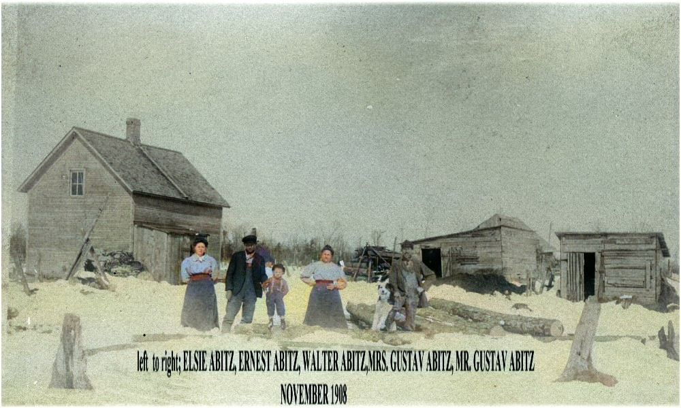

Slide 33
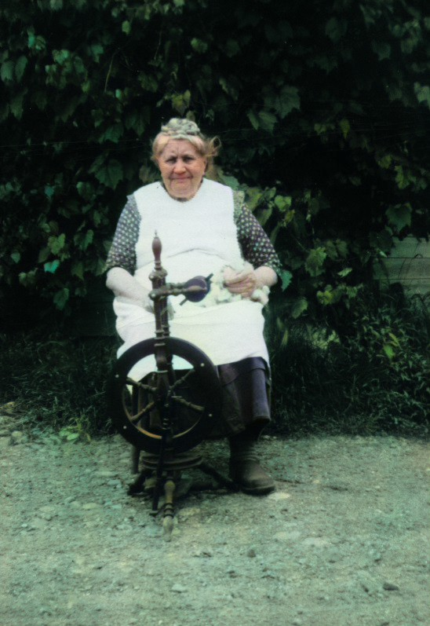
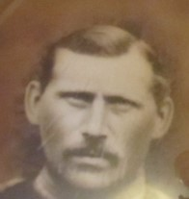
Elise’s
Parents
Henriette
Gus

Slide 34
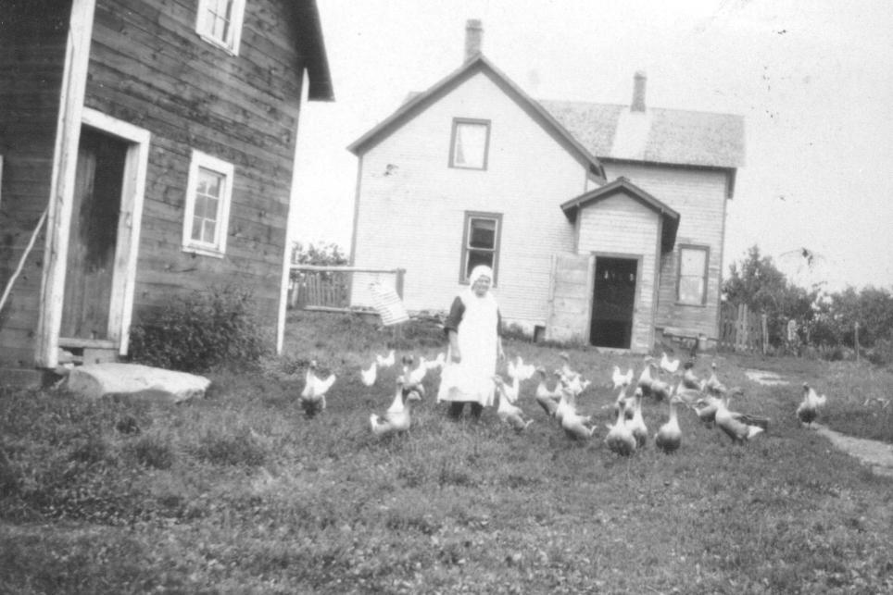
Henriette

Slide 35
Elise Elsie Abitz
Went to work in Milwaukee at age 15/16
Housekeeper

Slide 36
Gus and Walter Abitz Worked at sawmill with Michael

Slide 37
Married in 1910 in Medford
Michael was 24 years old
Elise was 17 years old
Knew each other for short period of time

Slide 38
Michael spoke 5 languages: German Russian Armenian Yiddish English

Slide 39
Athens
Michael worked at sawmill
Edwin, Fred, and Esther born in Athens
Edwin
Fred

Slide 40
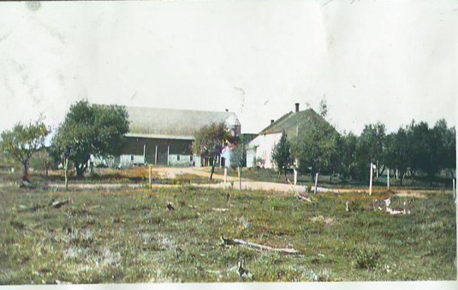
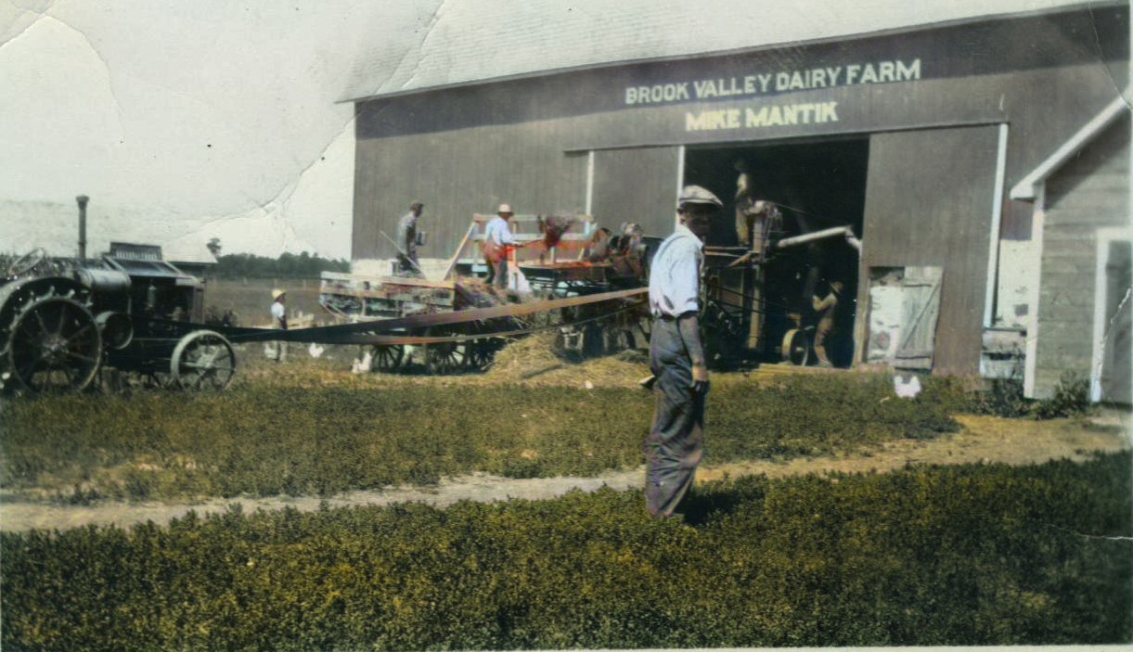
1916 Bought Milan Farm
Cost $3000
60 acres

Slide 41
Moved from Athens to Milan Farm

Slide 42
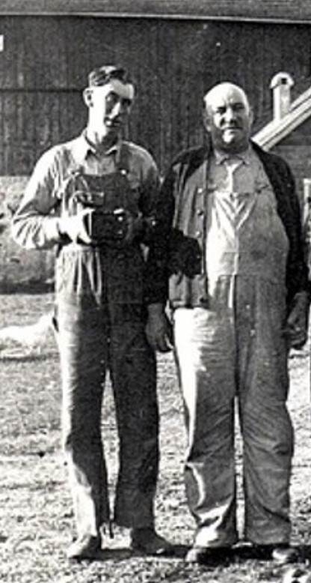
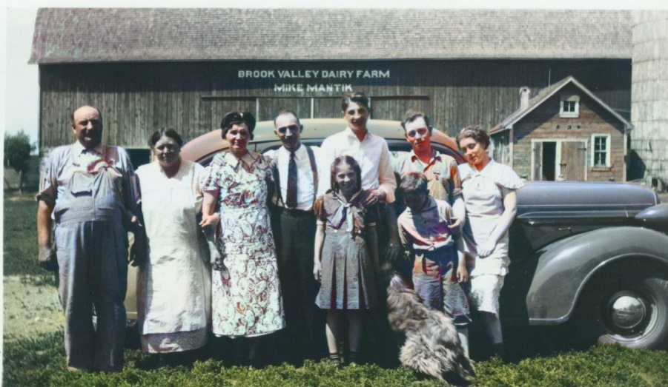
Milan Farm

Slide 43
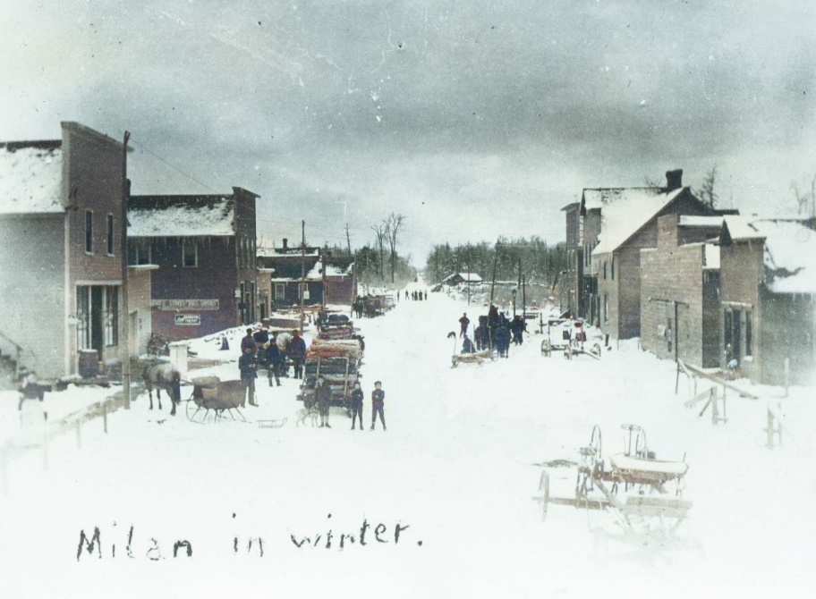
Milan

Slide 44
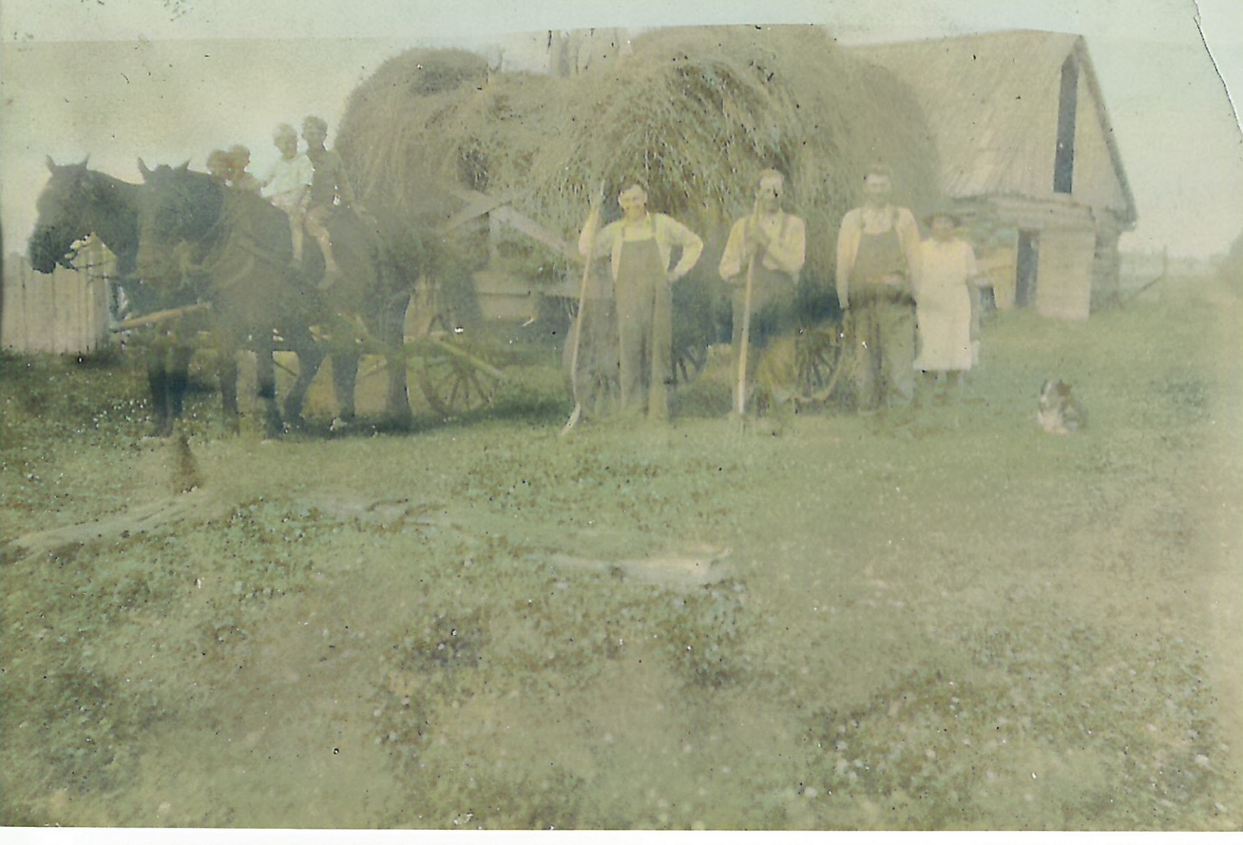

Slide 45
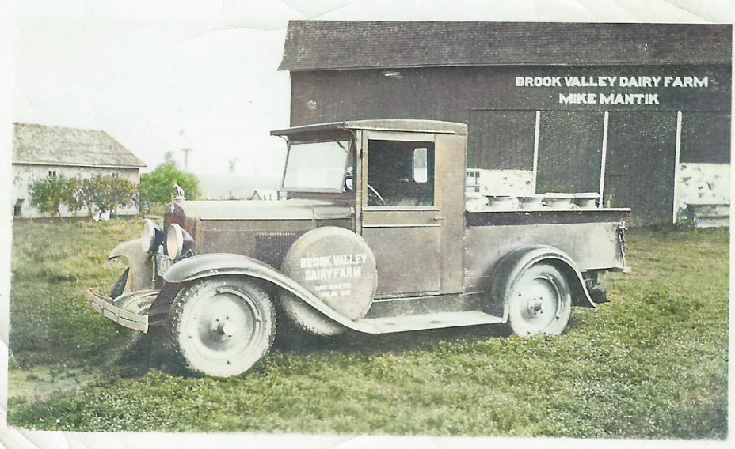

Slide 46
Milan School

Slide 47
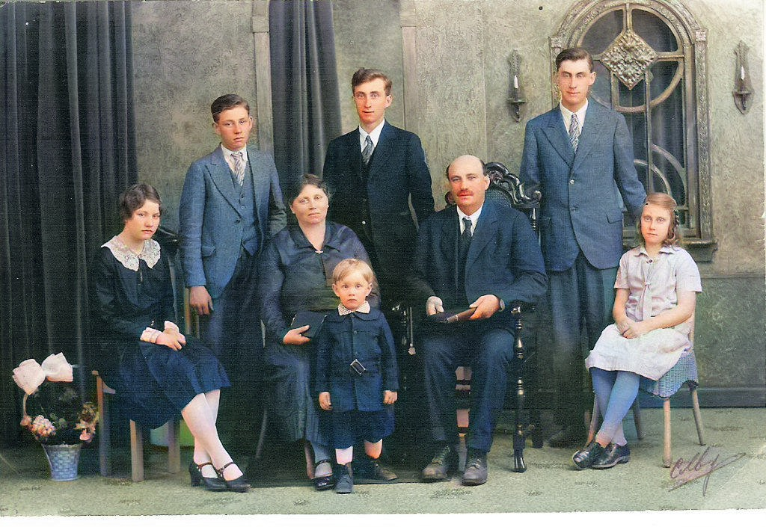
Edwin
Fred
Rueben
About 1930/1931
Esther
Evelyn
Enose
Enos

Slide 48
About 1938/1939
Edwin
Rueben
Evelyn
Fred
Esther
Enos

Slide 49
4 Generations Elise Henriette Edwin David

Slide 50
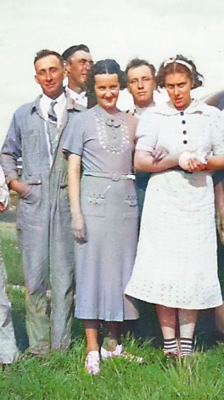

Slide 51
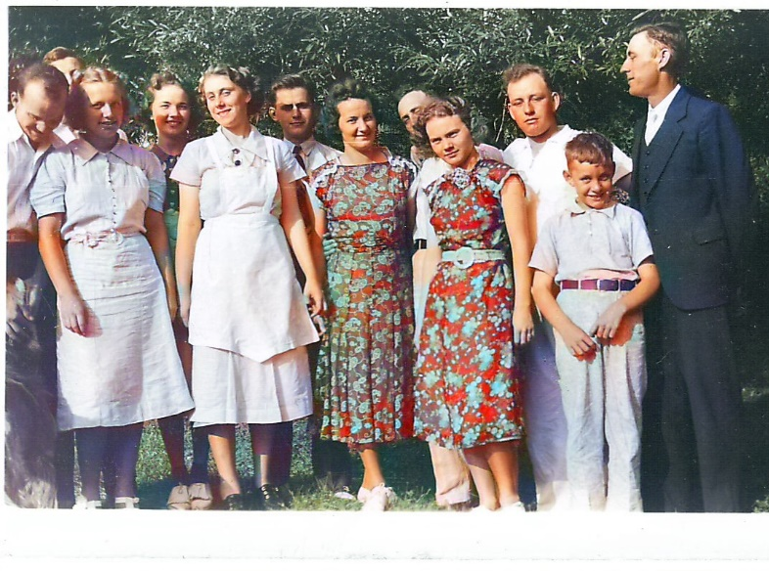
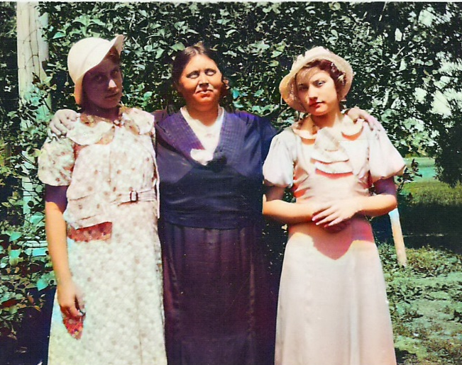

Slide 52
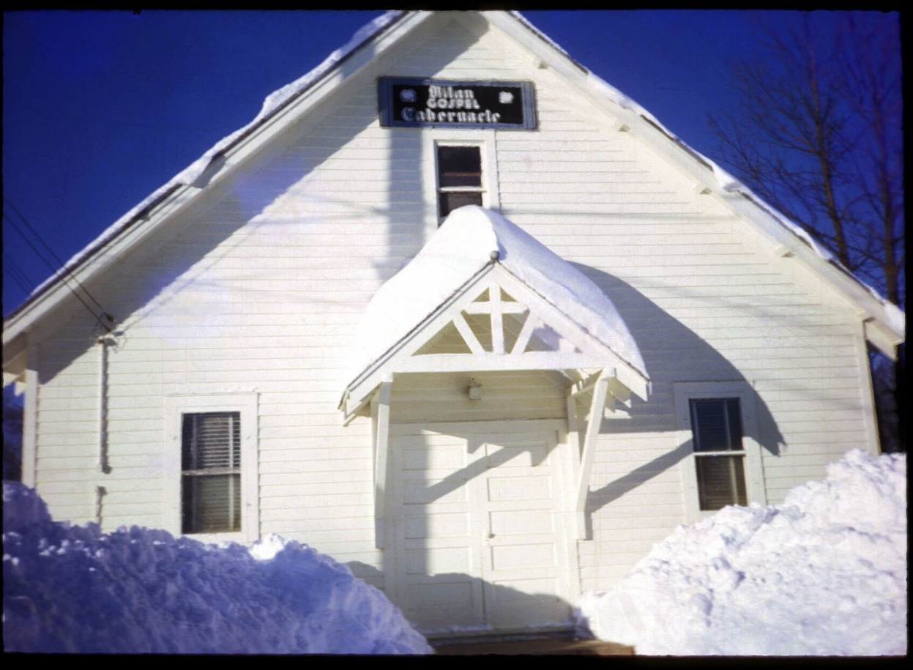
Milan Church

Slide 53
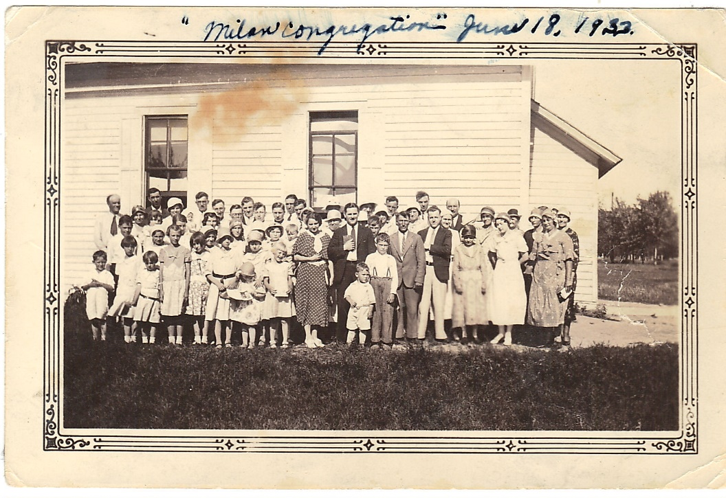
Milan Congregation

Slide 54
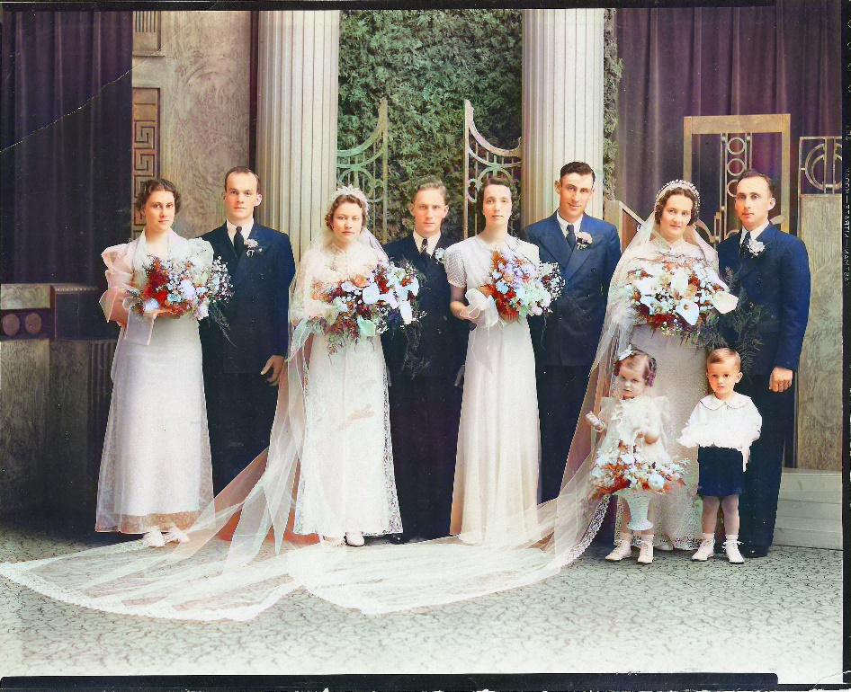
Marriage of the Children Esther and Herb Paulson Fred and Emilie 1938

Slide 55
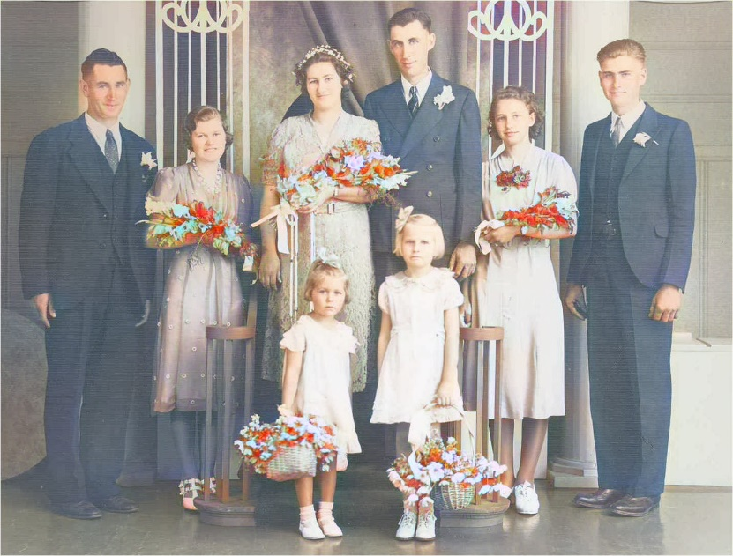
Marriage of the Children Edwin and Martha 1939

Slide 56
Marriage of the Children Evelyn and Ed Ostertag 1942

Slide 57
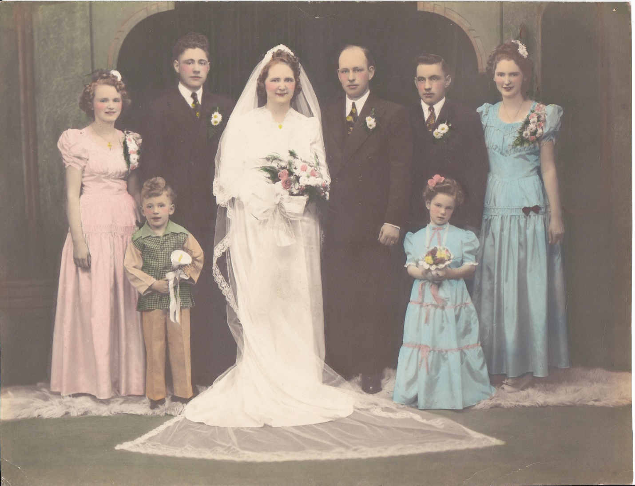
Marriage of the Children Rueben and Violet 1943

Slide 58
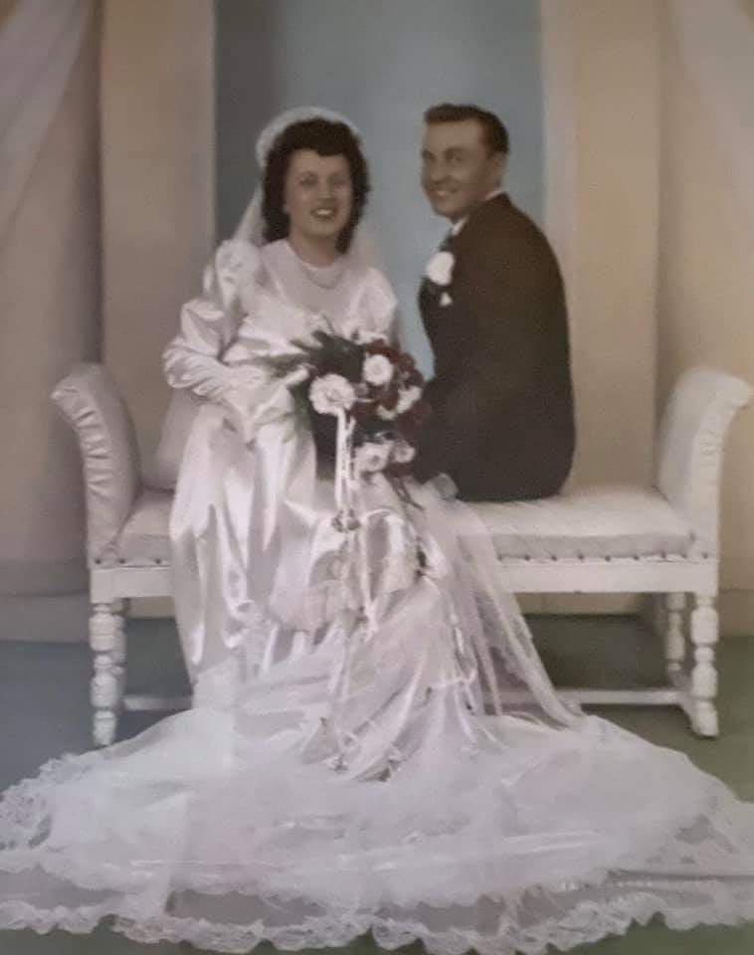
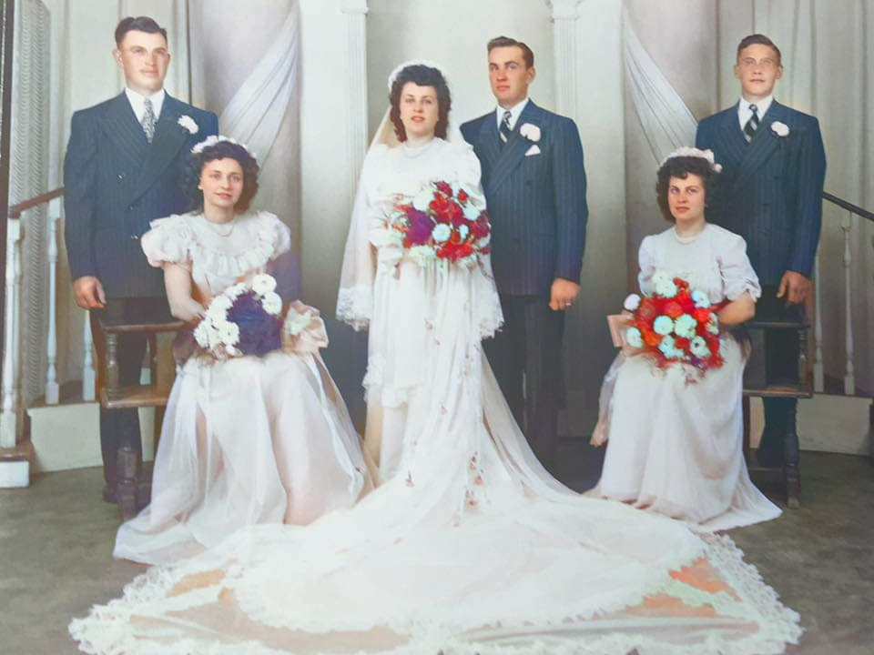
Marriage of the Children Enos and Evelyn 1947

Slide 59
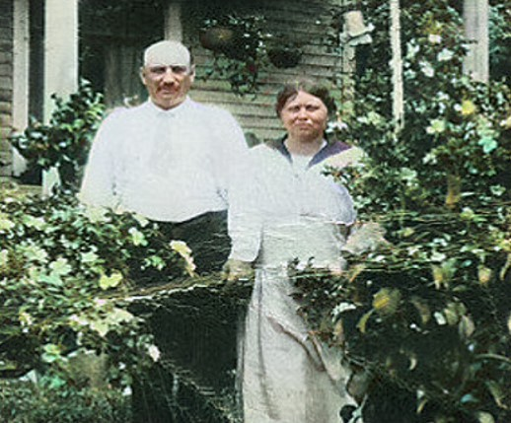
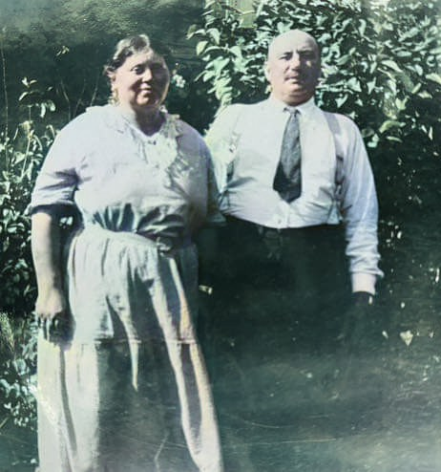
Michael and Elise

Slide 60
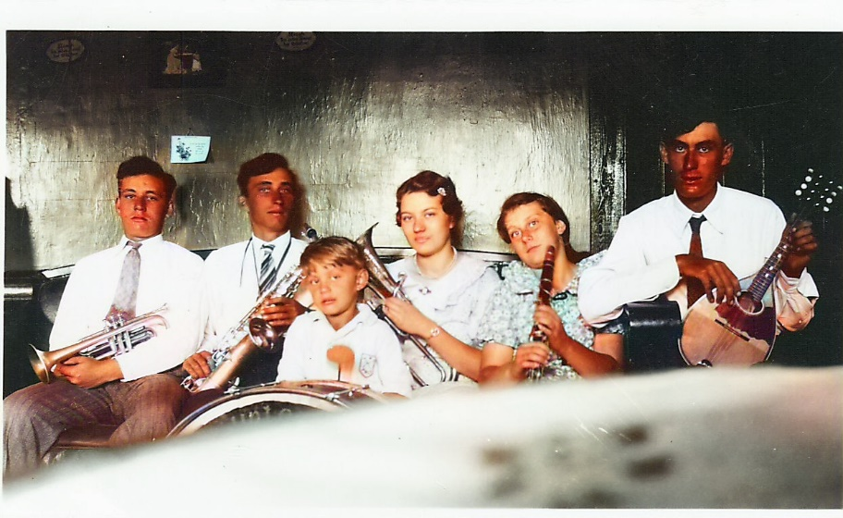
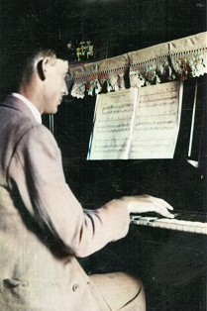
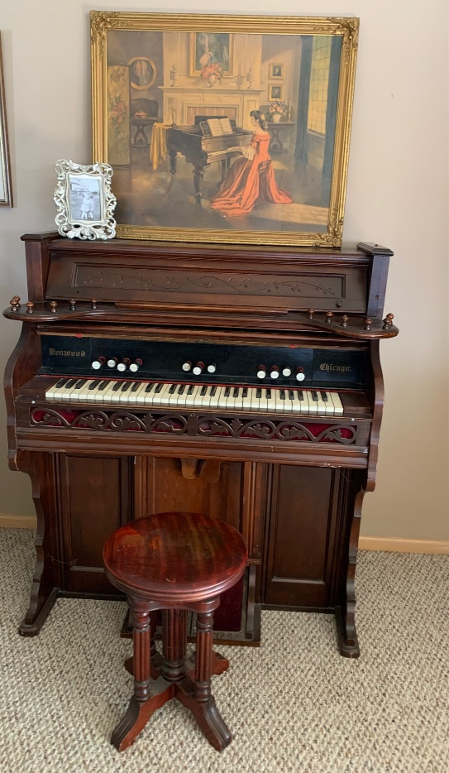
Musical Mantiks

Slide 61
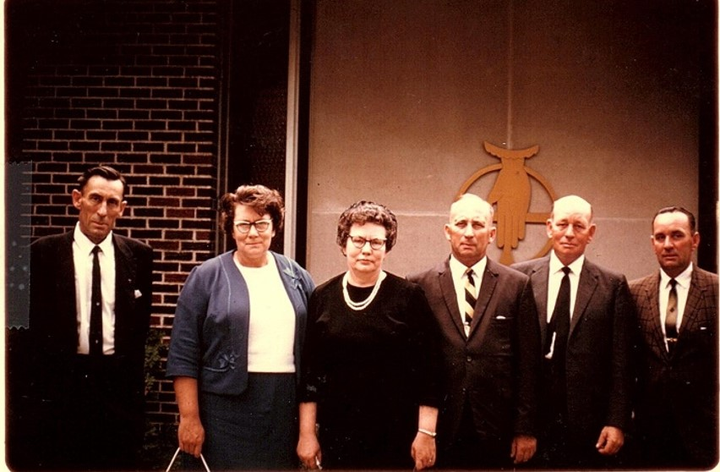
1968 – Herb Paulson’s Funeral

Slide 62
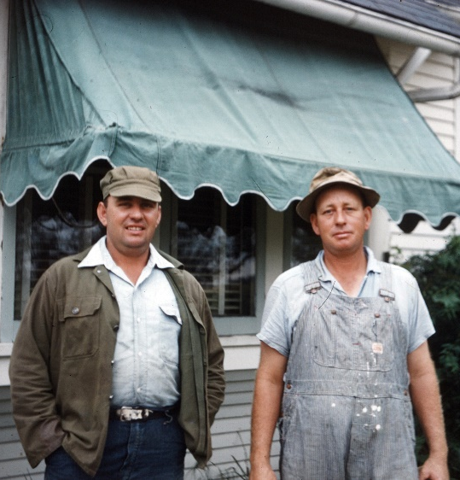
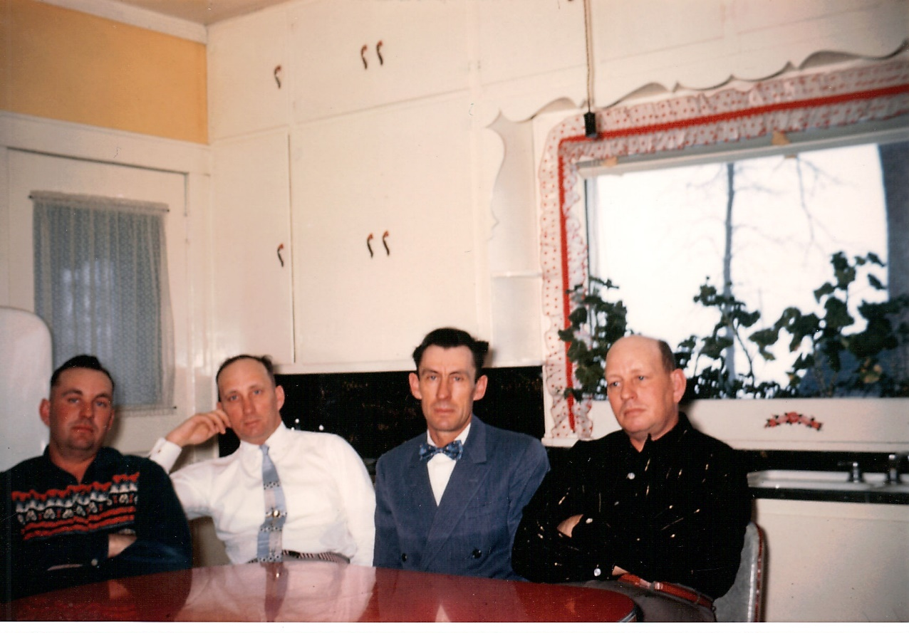

Slide 63
Elise Elsie 1893-1941
Died at wedding reception for Elmer and Lillian Jensen
Cause of death – heart issues
She was 48 yr old

Slide 64
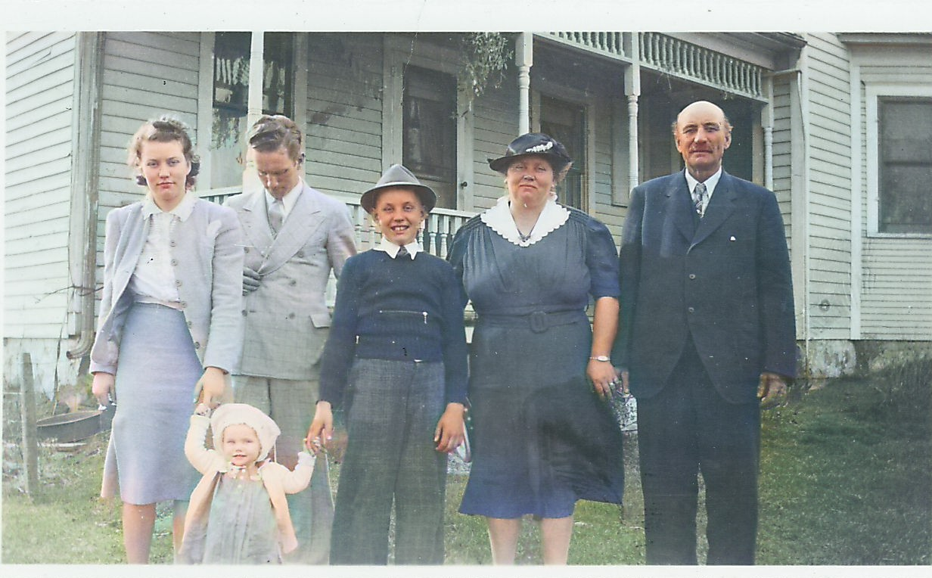
Michael 1886-1944
Had heat stroke in 1938
Last 2 ½ yr of life was in asylum

Slide 65
Michael 1886-1944
Had heat stroke in 1938
Died of kidney complications
He was 55 years old

Slide 66
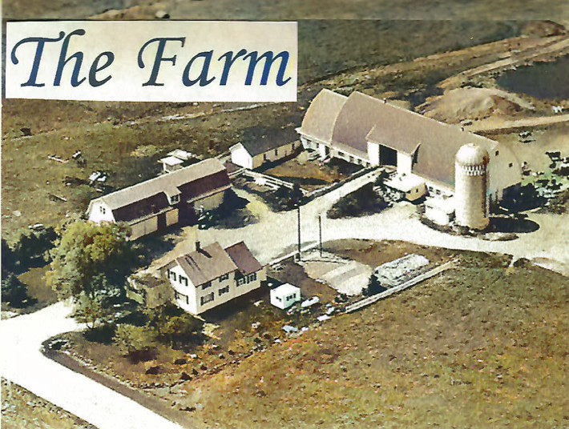

Slide 67
Fred and Emilie’s Farm

Slide 68
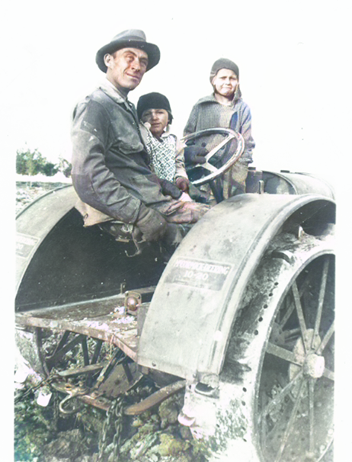
Milan Farm

Slide 69
The Mantik Name
Original French name of de Manthe from southwest France
Metamorphosed into various iterations: Mantei, Mante, Mantee, Mannte, Mantich, Manthei, Mantek, Mantai, Montuck, Montuk, Mantey, Mantaj, Montei, Montag, Mantyk, Manthey, Manthei, Mantica, Mantyk
Sometimes even into Mantick or Mantik

Slide 70
Descendants of Michael and Elise
 | Edwin | Fred | Esther | Rueben | Evelyn | Enos | Total=7
Kids | 4 | 6 | 10 | 8 | 9 | 4 | 41
Grandkids | 6 | 17 | 39 | 17 | 23 | 4 | 106
Great Grandkids | 7 | 40 | 22 | 24 | 29 | 3 | 125
Great- Great- Grandkids | 0 | 34 | ? | 12 | 6 | 0 | 52
Total | 17 | 97 | 71 | 61 | 67 | 11 | 331

Slide 71
How Many Descendants from Michael and Elise?
7 Kids

Slide 72
How Many Descendants from Michael and Elise?
7 Kids
41 Grandkids

Slide 73
How Many Descendants from Michael and Elise?
7 Kids
41 Grandkids
106 Great Grandkids

Slide 74
How Many Descendants from Michael and Elise?
7 Kids
41 Grandkids
106 Great Grandkids
125 Great-Great Grandkids

Slide 75
How Many Descendants from Michael and Elise?
7 Kids
41 Grandkids
106 Great Grandkids
125 Great-Great Grandkids
52 Great-Great-Great Grandkids

Slide 76
How Many Descendants from Michael and Elise?
7 Kids
41 Grandkids
106 Great Grandkids
125 Great-Great Grandkids
52 Great-Great-Great Grandkids
Total of 331 Descendants

Slide 78
Jerry and Carol
Descendants
7 Kids
19 Grandchildren
27 Great Grandchildren

Slide 79
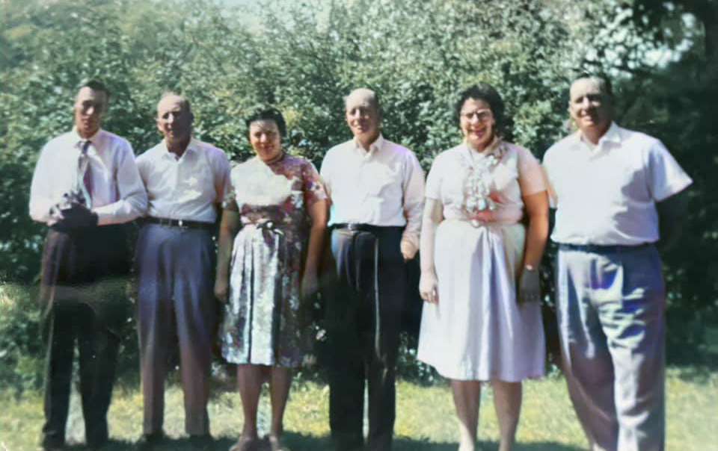
Michael and Elise were incredibly influential in providing their children with a spiritual heritage

Slide 80
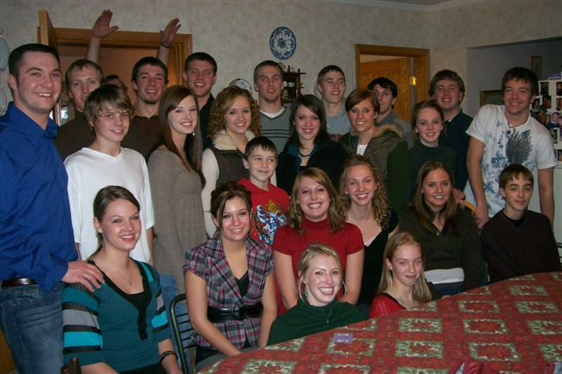
Proverbs 13:22 says “a good man (person) leaves an inheritance for his children’s children.”

Slide 81
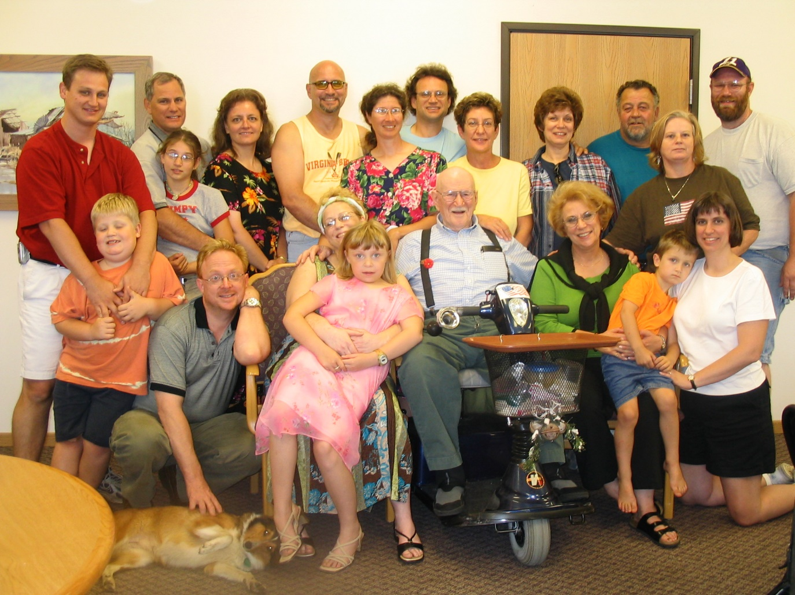
Proverbs 13:22 says “a good man (person) leaves an inheritance for his children’s children.”

Slide 82
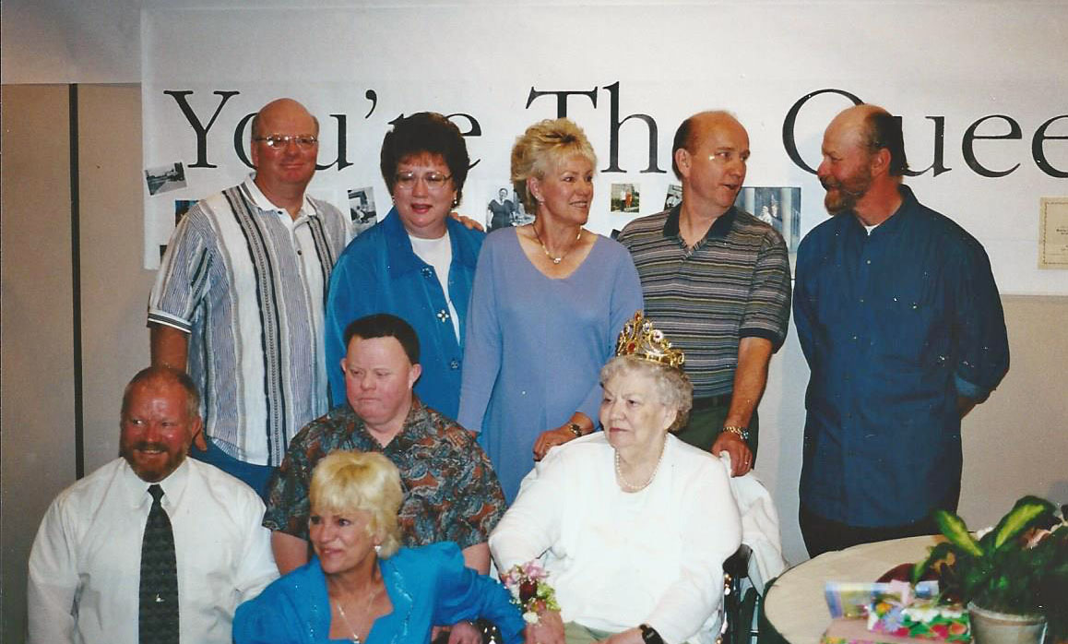
Proverbs 13:22 says “a good man (person) leaves an inheritance for his children’s children.”

Slide 83
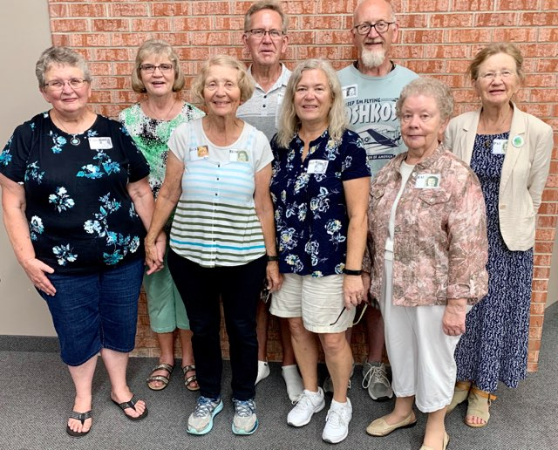
Proverbs 13:22 says “a good man (person) leaves an inheritance for his children’s children.”

Slide 84
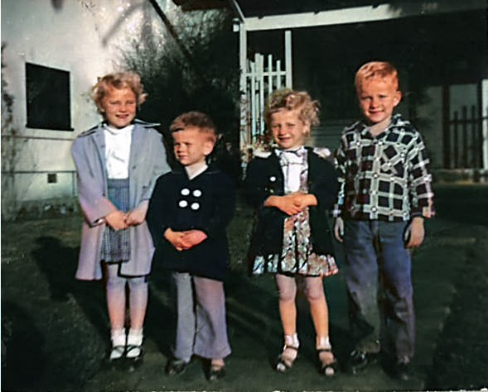
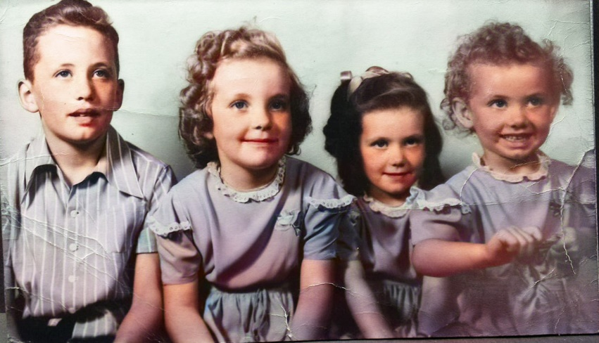
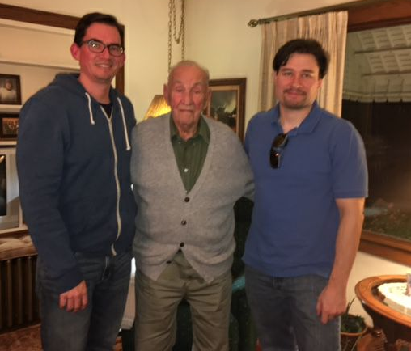
Proverbs 13:22 says “a good man (person) leaves an inheritance for his children’s children.”

Slide 85
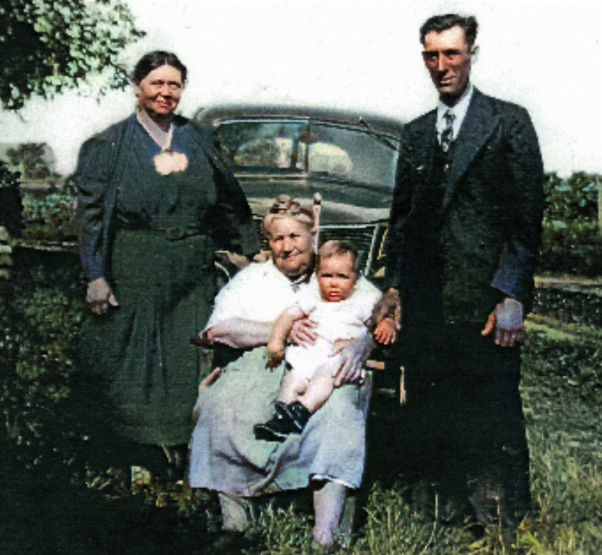
This family has been blessed with a great religious heritage that has been passed down from one generation to another

Slide 86
This family has been blessed with a great religious heritage that has been passed down from one generation to another

Slide 87
Many years and life events have gone by since this story began

Slide 88
As we look back over those years, we are very proud of our spiritual and family heritage and thankful to God who has looked after us

Slide 89
None of us would be where we are today or who we are if it had not been for the loving grace of God.

Slide 90
Our goal should be to connect our kids and grandkids to God and family

Slide 91
find us faithful w/ Lyrics - YouTube
https://www.youtube.com/watch?v=zi-Mn5tRHvM
find us faithful w/ Lyrics - YouTube

